Slide 1



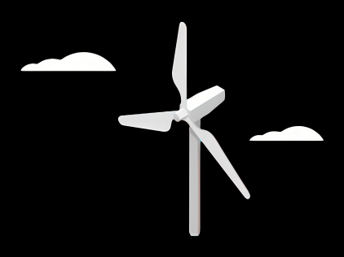
Gearbox, Brake, Coupling
Group Members :
Nehang Jitendra Joshi
Santo Mazumder
Md Razaul Karim Rahat
Arham Memon
Week number : 03
Date: 07/10/2025
Supervisor: Prof. Peter Quell

Slide 2
Agenda for 3rd week
Team design
Concept of drive train choice
Basic idea about brake system
Insight about the coupling
Coordinate with internal group--
Rotor hub,Bearing,Machine bed (Mechanical Input)
Electrical Drivetrain Team (Mechanical Output)
Chapter | Responsible person
Introduction | All team members
Project order | All team members
Gearbox | Nehang + Arham
Rotor brake | Rahat+Nehang
Coupling | Santo+Nehang

Slide 3
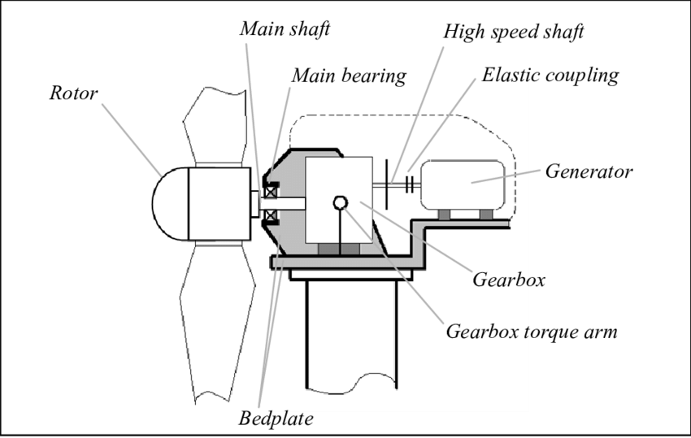
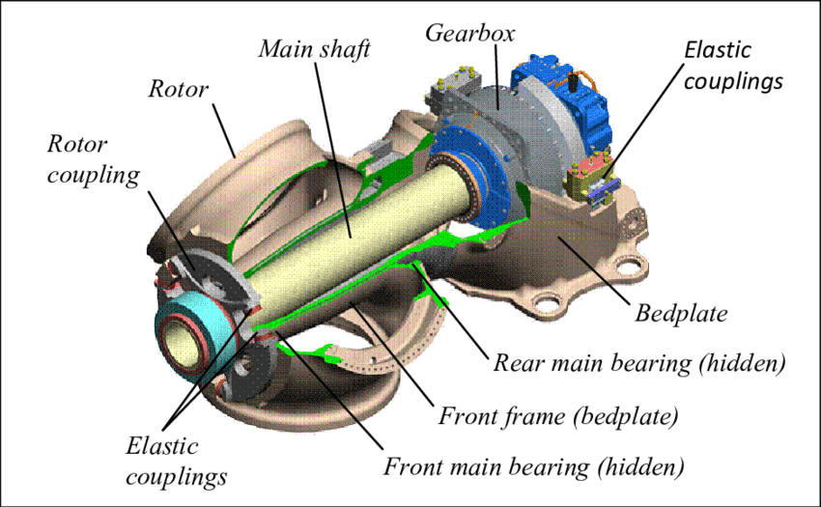
Drive train system
Main Objective:
Break down analysis of 3-Point suspension concept for each criteria of selection
Source-https://www.researchgate.net/

Slide 4
3-Point suspension
Paired comparison analysis for drive train
Criteria of drive train | 4Point suspension Modular | 3point suspension Semi-integrated | Integrated | hybrid | Direct drive
Low capex | 1 | 3 | 2 | 1 | 1
High serviceability | 3 | 3 | 1 | 1 | 1
Easy to assemble | 2 | 3 | 3 | 3 | 2
Availability of spear parts | 3 | 3 | 1 | 1 | 1
Light weight | 1 | 2 | 3 | 2 | 3
Transport | 3 | 3 | 1 | 1 | 2
Reliability | 1 | 2 | 2 | 2 | 3
Total Points
4Point suspension Modular --- 14
3point suspension Semi-integrated-- 19
Integrated-- 13
Hybrid-- 11
Direct drive-- 13

Slide 5
Criteria of drive train | 4Point suspension Modular | 3point suspension Semi-integrated | Integrated | hybrid | Direct drive
Low capex | High cost due to complexity, additional materials. | fewer components and simpler geometry | omplex design, tooling, and manufacturing | depends on how the hybrid is implemented. Can reduce cost through smart design | precision motor design and electronics needed.
High serviceability | More moving parts mean more maintenance | due to simplicity and fewer joints | difficult to access internal components without specialized tools | some parts are easy to fix, others not | fewer moving parts, but harder to repair motor if it fails
Easy to assemble | Requires precise alignment and more components to mount | often DIY-friendly | often assembled in factory only | custom instructions, especially if parts are not standardized | no chain or transmission
Availability of spear parts | especially in mainstream markets | due to standardization | harder to source and replace | some parts standard, others proprietary | specially if proprietary motor is used.
Light weight | due to extra linkages and hardware | design is a major benefit | helps reduce external mounts and improves aerodynamics | depending on materials and structure. | due to fewer mechanical parts
Transport | may require partial disassembly for shipping | better for packaging or folding designs | more fragile due to enclosed systems | some parts may be detachable, others fixed. | fewer parts means easier logistics
Reliability | especially in demanding terrain or under load. Built for durability | but may not perform well under heavy stress or rough terrain | components are protected from the elements. Risky if one part fails | if well-engineered – benefits from best of both worlds | no wear on chains/gears, fewer failure points.

Slide 6
Gearbox system
Main Objective:
Break down analysis of planetary gearbox concept for each criteria of selection.
Criteria Key Points for Planetary Gearbox.

Slide 7
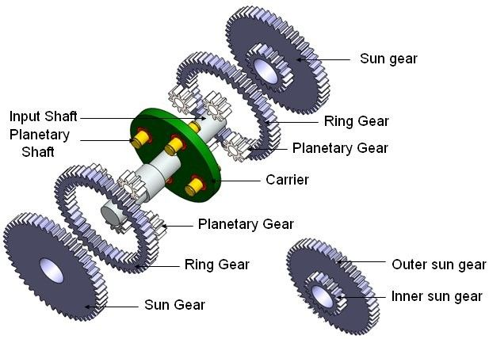
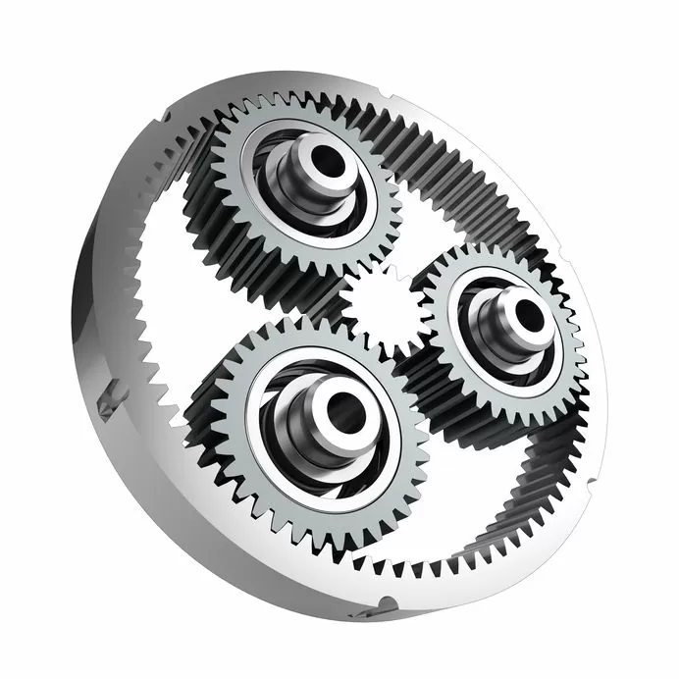
Gearbox system
Source- Planetary System gears by SMC
Manufactures

Slide 8
Gearbox system
Criteria Key Points for Planetary Gearbox
Design -Compact, multiple gear ratios, load sharing, low backlash possible
Manufacturing-Precision machining, heat treatment, quality materials, tight tolerances
Space Requirement-Very compact for torque output; coaxial design saves space
Weight- High torque-to-weight ratio; lightweight options available
Efficiency- High (95–98%), optimized by quality gears and lubrication
Reliability -Excellent with proper design and maintenance; robust against heavy-duty use

Slide 9
Rotor Brake
Main Objective:
Break down analysis of Rotor brake.
Criteria Disc Brake System.

Slide 10
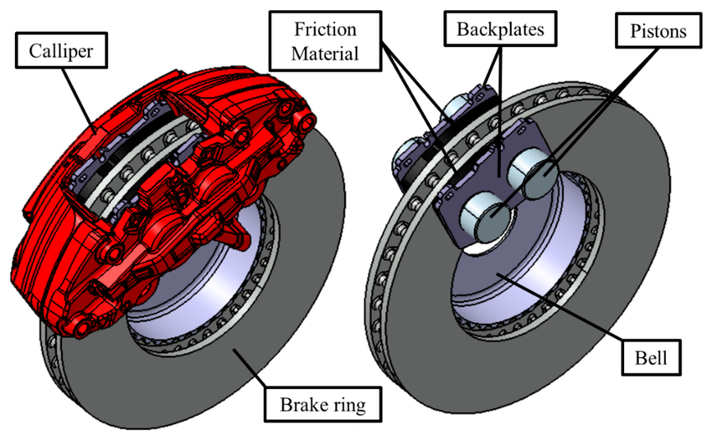
Rotor Brake
Source- KTG AUTO

Slide 11
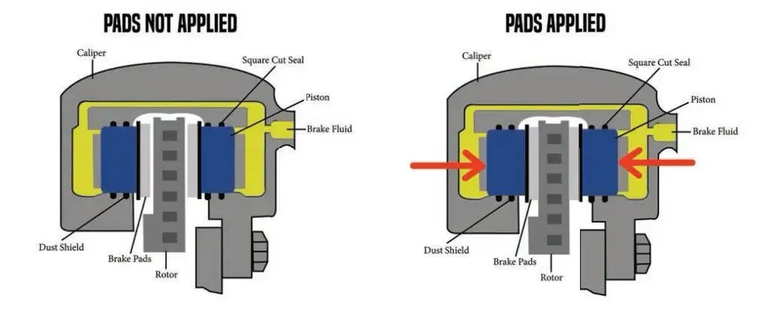
Rotor Brake
Source- KTG AUTO

Slide 12
Rotor Brake
Criteria Disc Brake System-
Design-Simple, open design with rotor, caliper, and pads. Good for cooling and modularity.
Manufacturing- Mature process; rotor and caliper materials vary with performance level.
Space Requirement-Compact design, but performance setups need larger wheels and calipers.
Performance & Pressure-Excellent braking, quick heat dissipation, linear pressure response.
Weight- Moderate; lighter than drums at high end, but heavier at low cost.
Maintenance & Reliability- Easy access, frequent pad changes, prone to corrosion/warping.
Cost- Affordable for mass production; premium for high-performance materials.

Slide 13
Coupling
Main Objective:
Break down analysis of Coupling
Criteria Coupling

Slide 14
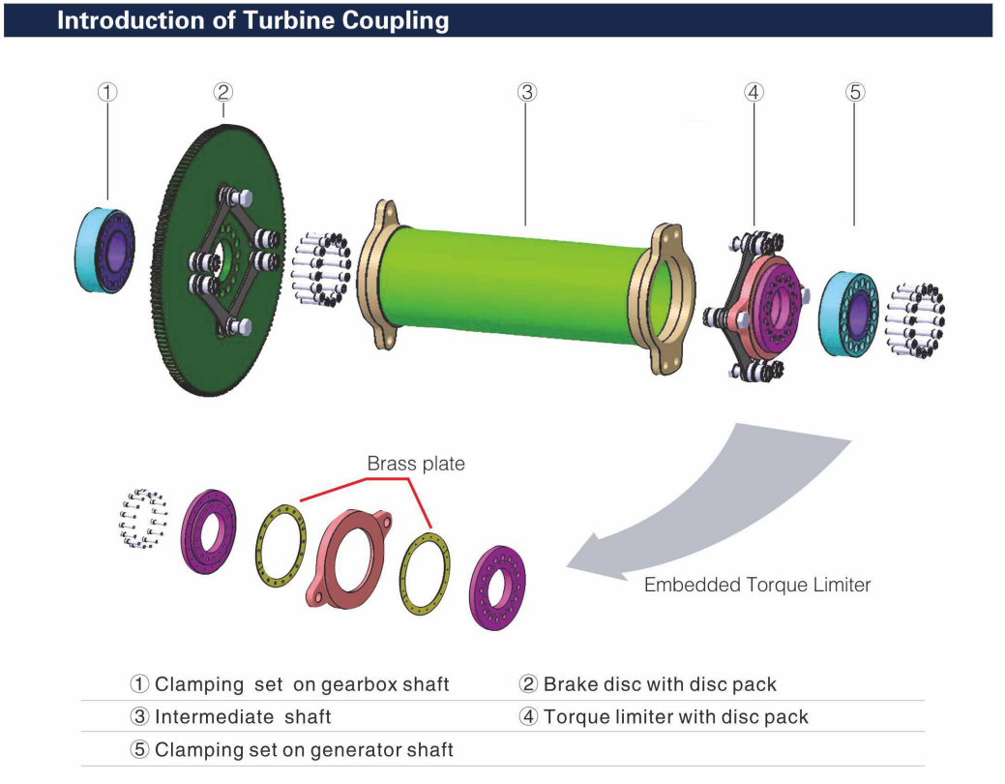
Coupling

Slide 15
Coupling
Criteria Disc Brake System-
Design-Compact, torsionally rigid, high misalignment capability
Protection-Requires external guards; corrosion-resistant options available
Efficiency--Very high (>99%), no backlash, no lubrication needed
Service & Maintenance- Low; visual inspection and alignment checks sufficient
Reliability & Weight-Very reliable, lightweight, fatigue-resistant
Cost-High upfront cost, low over time due to durability

Slide 16
Bibliography
https://www.twiflex.com/en/newsroom/2016/02/is-caliper-brake-solutions-for-wind-turbines
https://antec-group.com/wp-content/uploads/2021/12/Catalogo-Wind-2022.pdf
https://www.twiflex.com/en/newsroom/2016/02/is-caliper-brake-solutions-for-wind-turbines
https://www.windsourcing.com/en/spare-parts-and-repair-material/brakes/brake-calipers/
https://www.ktr.com/de/en/products/brake-systems/
https://www.zf.com/products/en/wind/home/wind.html#:~:text=Empowering%20a%20Sustainable%20Future%20Together&text=ZF%20Wind%20Power%20develops%2C%20together,future%20together%20with%20our%20partners.
https://www.flender.com/en/branchesAndApplications/winergy#:~:text=Two%20powerful%20brands%20%2D%20one%20company,wind%20for%20a%20better%20future.

